Slide 1
FROM FINDING AND OPTIMIZATION OF GRID-SHELLS USING FORCE DENSITY METHOD AND DISCRETE AIRY STRESS FUNCTION
Supervisor : Dr. Bharat Mandal
Presented By : Nishan Thapa (075Msste008)

Slide 2

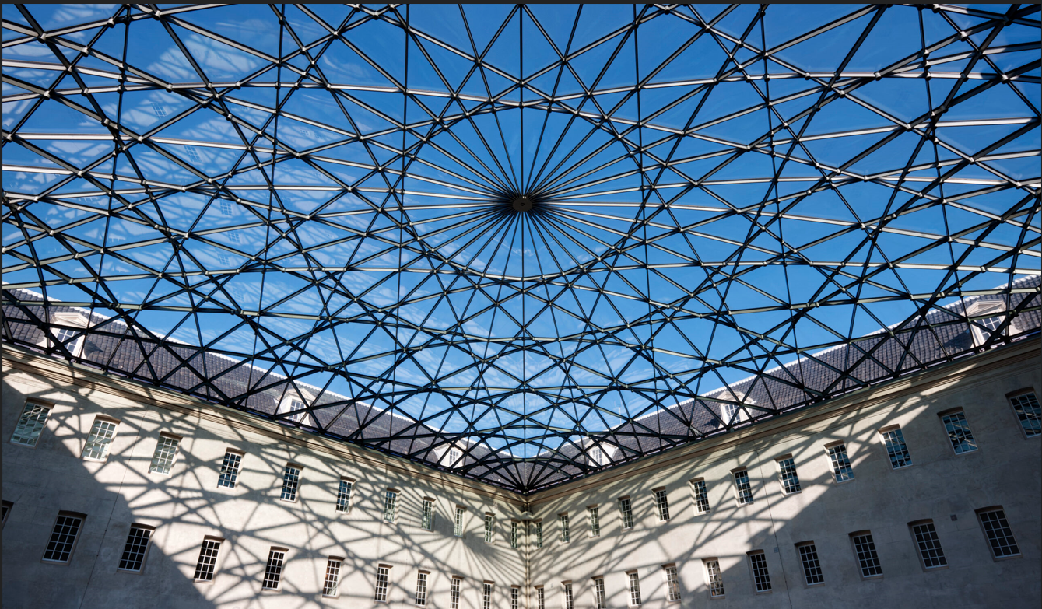
INTRODUCTION
CONTINUOUS SHELLS
GRID SHELLS
Figure 1 Continuous Shell - L'Oceanografic, City of Arts and Sciences, Valencia, Spain | Figure 2 Grid Shell - Glass roof Dutch Maritime Museum at Amsterdam, Netherlands
Advantages : Aesthetics and Efficiency.
Issues : Buildability and Design.
Form – Strength Interplay.

Slide 3
SHELL GEOMETRY GENERATION
Shell-Geometries for design can be generated by (Adriaenssens, et al., 2014) :
1. Free Form Shells (Arbitrary and nature inspired shapes)
2. Mathematical Shells (Spherical , Shell surface by mathematical function)
3. Form-found shells ( Dynamic Relaxation, Force Density Method, Hanging Chain Models)

Slide 4
RESEARCH STATEMENT / MOTIVATION
Structural Performance = Architectural Form
Material Efficiency
Structural Performance ≠ Architectural Form
Material Inefficiency
Generation of Grid shell forms inspired by Structural Performance..
Exploration of Structural Form of Grid Shells using Graphical Methods

Slide 5
LITERATURE REVIEW
1. Maxwell, J. (1864,1867,1870) - Systemic Development of Graphic Statics and Application of Airy Stress Function for trusses
2. G.B. Airy (1862) - Airy Stress Function to determine strain in cantilever beams.
3. Scheck (1970) - Force Density Method for form finding of Tensile Nets.
4. Block & Ochsendorf, 2007 - Force Density Method & Graphic Statics for analysis of compression only or tension only funicular structure.
5. McRobie, et al., 2016 & Mitchell , et al., 2016 - External and internal forces could be interchanged in Airy stress projection.
6. Konstantatou, 2019 - Force Density Method & Airy Stress Function for design exploration of tension-compression grid shells.

Slide 6
OBJECTIVE
General Objective:
The general objective of this research is to explore the Form Finding and Optimization of grid-shells.
Specific Objectives :
Determine the variation of grid shell weight, height, and deflection values for variation in grid density (shape), topology and force density values in a case study of a 12m*12m rectangular grid shell.
Determine optimum grid shell for given limitations in weight and height values.
Study variations among grid shells determined using uniform force density and force densities from airy stress function.
Develop a Design tool that suggests structurally robust grid-shells at early phase of design.

Slide 7
LIMITATIONS
Uniform Static Load over shell surface taken as dominant load case.
No considerations for buckling .
Connections assumed to be hinged and connection complexity not taken for optimization.

Slide 8
CONCEPTS
Force Density Method
Airy stress function - Continuous, Discrete
Graphic Statics
Genetic Algorithm

Slide 9
FORCE DENSITY METHOD
Developed by HJ Schek in 1974 AD for form finding of general networks of hanging cables, bars and membranes.
Force density ratio ( FD) = Member Force (S) / Member Length (q)
Features include (Cercadillo- Garcia & Fernandes-Cabo, 2016) :
Linearizes nonlinear geometry and static equilibrium problem using parameter force density.
Manages equilibrium equations in totally direct way suited for funicular solutions.
No member pre-sizing and geometry required.
Equilibrium equations are uncoupled.

Slide 10
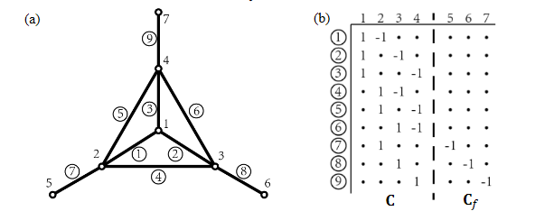
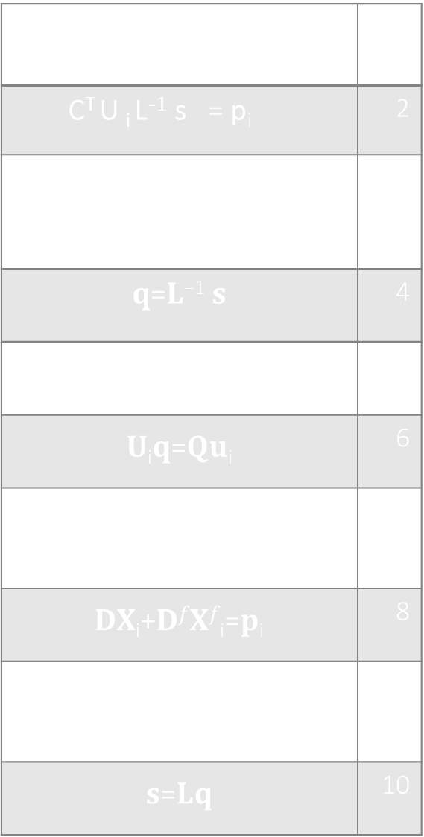
FORCE DENSITY METHOD
u _{i} = C X _{i} + C _{f} X ^{f} _{i} | 1
C^{T} U _{i} L⁻¹ s = p_{i} | 2
$$\frac{∂l}{∂xi}=C^{T}U{iL}^{−1}$$ | 3
𝐪=𝐋⁻¹ 𝐬 | 4
𝐂^{T}𝐔_{i}𝐪=𝐩_{i} | 5
𝐔_{i}𝐪=𝐐𝐮_{i} | 6
𝐂^{T}𝐐𝐂𝐱_{i}+𝐂^{T}𝐐𝐂^{𝑓}𝐱^{𝑓}_{i}=𝐩_{i} | 7
𝐃𝐗_{i}+𝐃^{𝑓}𝐗^{𝑓}_{i}=𝐩_{i} | 8
𝐗_{i} = D⁻¹ (𝐩_{i} - 𝐃^{𝑓} 𝐗^{𝑓}_{i}) | 9
𝐬=𝐋𝐪 | 10
 | List of Symbols
u | u- co-ordinate difference
C | Branch Node Connectivity Matrix for free nodes
C_{f} | Branch Nodes Connectivity Matrix for fixed nodes
X | ordinate of point
U | Co-ordinate difference Matrix
L | Member Length Matrix
s | Member forces
P | Member force along axis
D | C^{T} Q C
D^{f} | C^{T} Q C^{f}
q | Member force density
Grid System and Branch Node Matrix
Einstein’s Notation
i == x,y,z

Slide 11
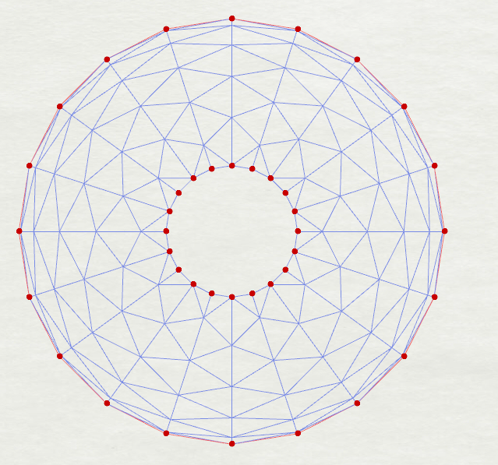
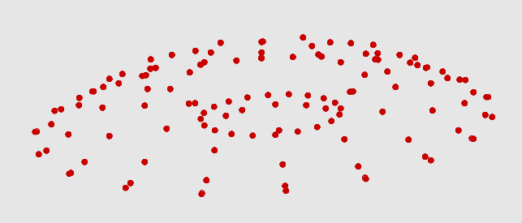
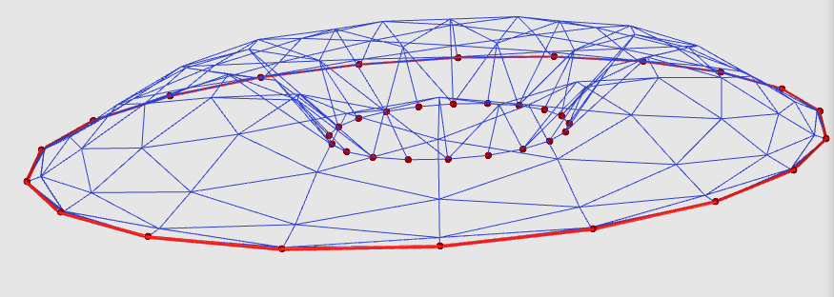
FORCE DENSITY METHOD
INPUT
FUNCTION
OUTPUT
NODAL CO-ORDINATES OF THE POINTS IN EQUILIBRIUM
FORCE DENSITY METHOD
( Schek, 1974)
1. 2D LINE MESH
2. FORCE DENSITY
3. NODAL LOADS
(X, Y or Z direction)
4. FIXED POINTS
5. CONSTRAINTS
( NOT CONSIDERED)
NOTE:
OUTPUTS OF AIRY STRESS FUNCTION CAN BE USED AS :
CHANGE IN SLOPE BETWEEN SURFACES/ PROJECTED LENGTH AS FORCE DENSITIES
PROJECTION OF FUNCTION AS 2D LINE MESH ( TOPOLOGY OF MESH)
FINAL SHAPE AND MEMBER FORCES

Slide 12
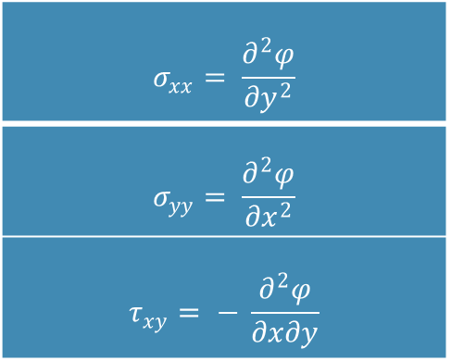


AIRY STRESS FUNCTION
George Bidell Airy ( 1862) formulated Airy Stress Functions for determination of stresses in cantilever bridges .
A 3D surface $φ(x, y)$ over 2D xy-plane that contains the structure, the differentiation of which gives the following :
Where,
$σ$_{xx} , $σyy$ Normal Stress along x and y directions.
$τ_{xy}$ Shear Stress along xy plane.
$φ$ Assumed Airy Stress Function
$$σ_{xx}= \frac{∂^{2}φ}{{∂y}^{2}}$$
$$σ_{yy}= \frac{∂^{2}φ}{{∂x}^{2}}$$
$$τ_{xy}= − \frac{∂^{2}φ}{∂x∂y}$$

Slide 13
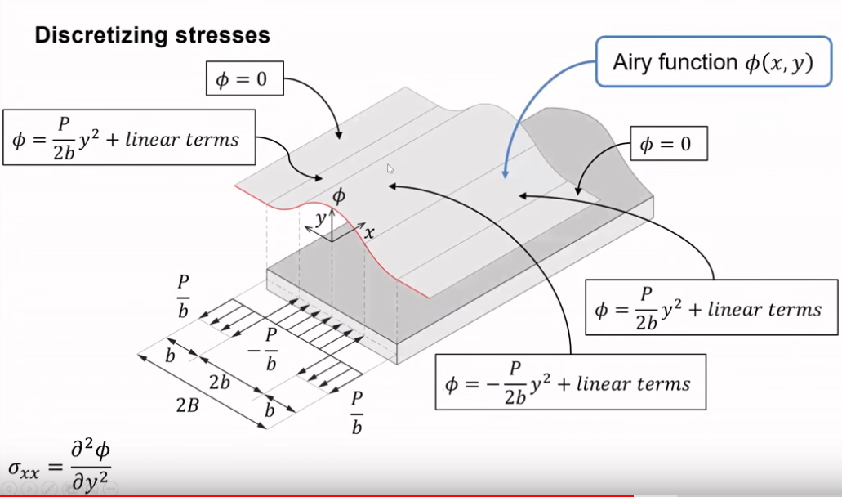
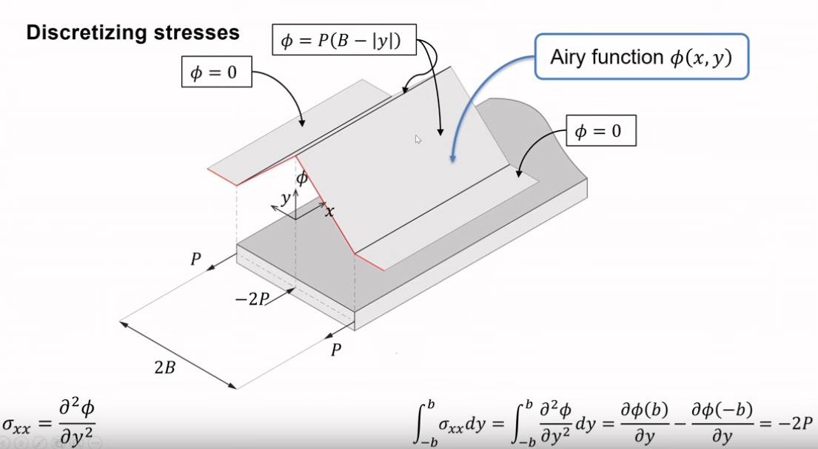

AIRY STRESS FUNCTION
$$σ_{xx}= \frac{∂^{2}φ}{{∂y}^{2}}$$ | $\frac{∂σ_{xx}}{∂x}+\frac{∂σ_{xx}}{∂x}+fx$ = 0 | $\frac{∂^{3}φ}{∂y∂y∂x}+\frac{∂^{3}φ}{∂x∂y∂y}$ 0
$$σ_{yy}= \frac{∂^{2}φ}{{∂x}^{2}}$$ | $\frac{∂σ_{xx}}{∂x}+\frac{∂σ_{xx}}{∂x}+fy$ = 0 | $\frac{∂^{3}φ}{∂x∂y∂y}+\frac{∂^{3}φ}{∂y∂x∂x}$= 0
$$τ_{xy}= − \frac{∂^{2}φ}{∂x∂y}$$

Slide 14
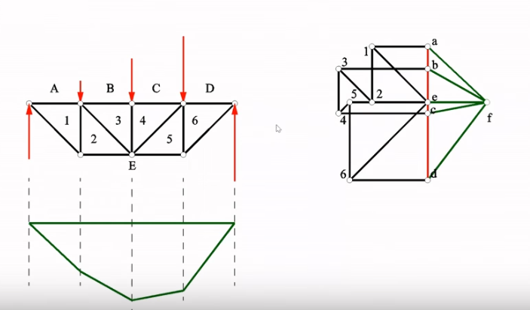
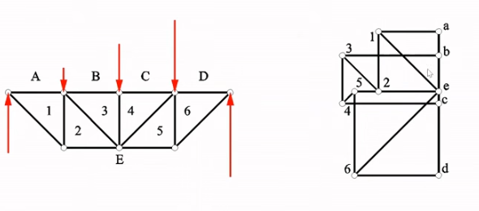
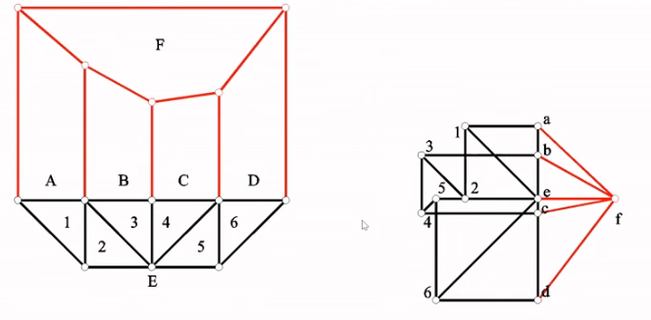
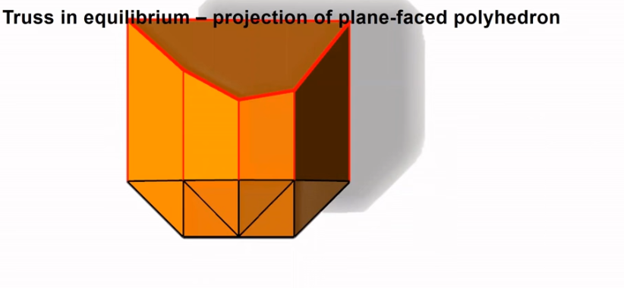
GRAHPIC STATICS
Form and Force Diagram (Maxwell, 1864 – Mitchell, et al., 2016)
Form and Force Diagram (Cremona – Mitchell, et al., 2016)
Plane Faced polyhedron representing truss

Slide 15
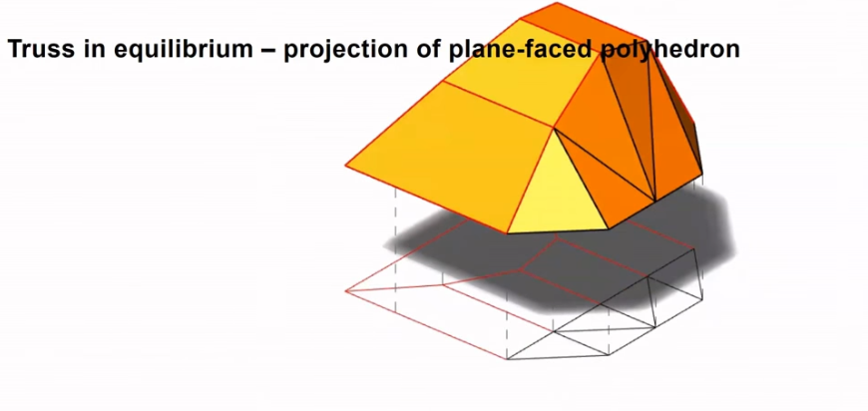
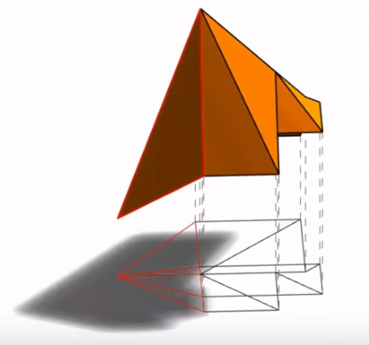
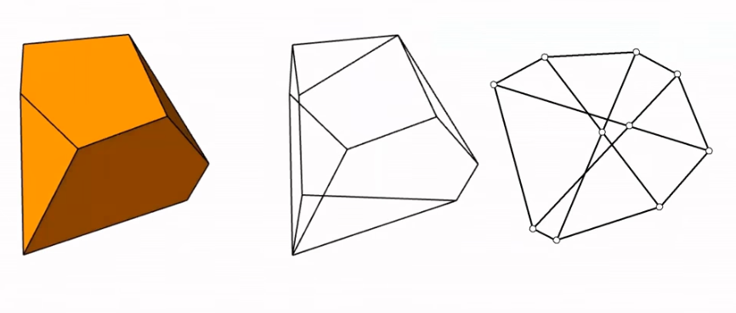
GRAHPIC STATICS
Form Diagram as projection of Plane faced polyhedron
Force Diagram as projection of Plane faced polyhedron
Any Plane Faced Polyhedron’s projection
gives a self stressed truss.
Pellegrino S. , 1986

Slide 16
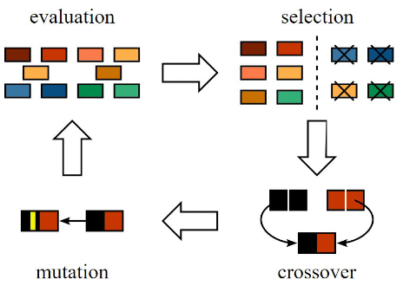
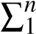
OPTIMIZATION METHOD : GENETIC ALGORITHM
Features :
Heuristic Method
Flexible Problem Formulation
Fluid integration in Design Space
Minimization Function used for grid shell with height = 1.5m is :
Minimize, W = | FiLi∗(h-1.5)^2,
where, | F_{i} = force in individual member
 | L_{i =} member length
 | h= grid-shell height obtained
 | n = no. of members.
General Overview of Genetic Algorithm

Slide 17
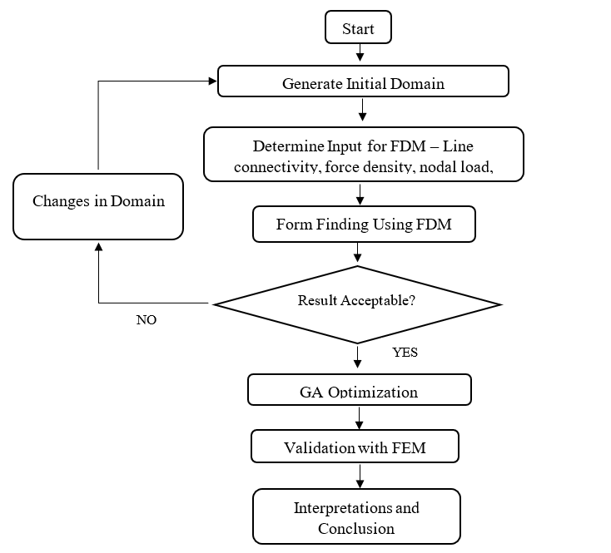
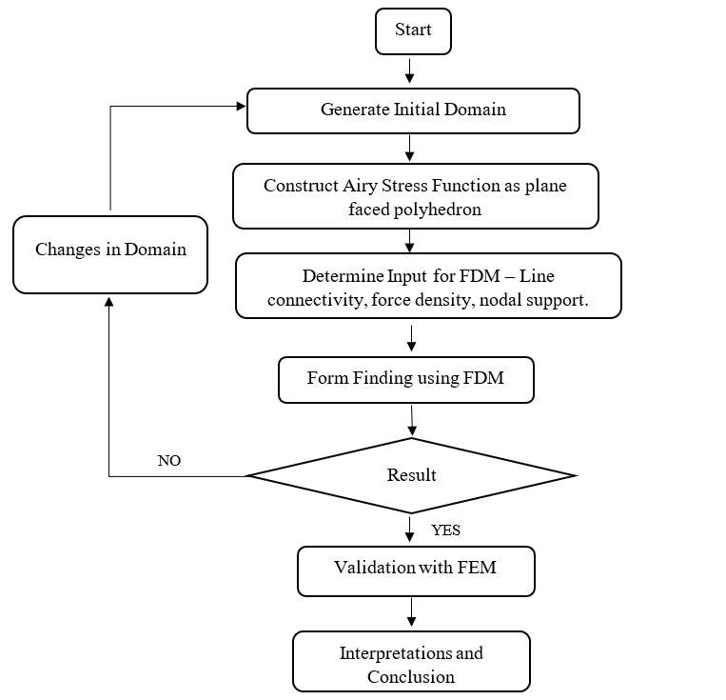
METHODOLOGY

Slide 18
DESIGN TOOL WORKFLOW
Uniform Force Density
Domain Construction – Idealization and
Design Topology
FORCE DENSITY METHOD
FUNICULAR
GRID SHELL
Airy Stress Function for Force Density
OPTIMIZATION USING GENETIC ALGORITHM
FORCE DENSITY METHOD
TENSION- COMPRESSION GRID SHELL
FEM VALIDATION AND CONNECTION DESIGN

Slide 19
METHODOLOGY
SOFTWARES USED
Rhino –Grasshopper : Parametric Environment.
Python : Programming Language
Karamba : FEM Validation and Deflection Calculation.
Galapagos : Evolutionary Solver (Plugin in Grasshopper)
Ladybug, Weaverbird… ( Meshing and Panelization).

Slide 20
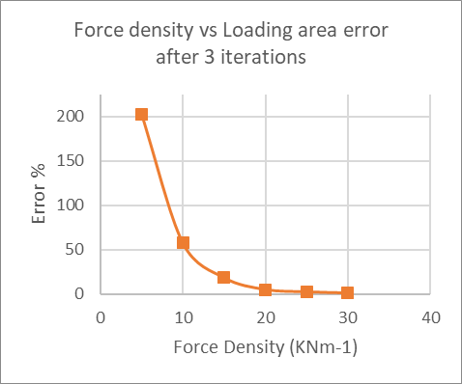
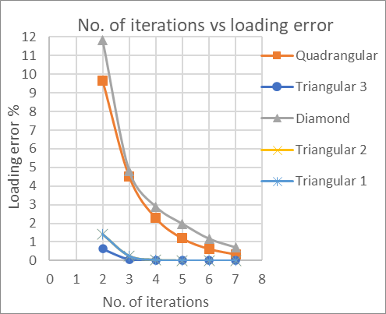
METHODOLOGY
Grid shell loading : Uniformly distributed static load of 5KNm⁻² is taken throughout the study, which is applied to the nodes as per their tributary area. Three iterations taken to minimize errors in loading values.
MODELLING PARAMETERS

Slide 21
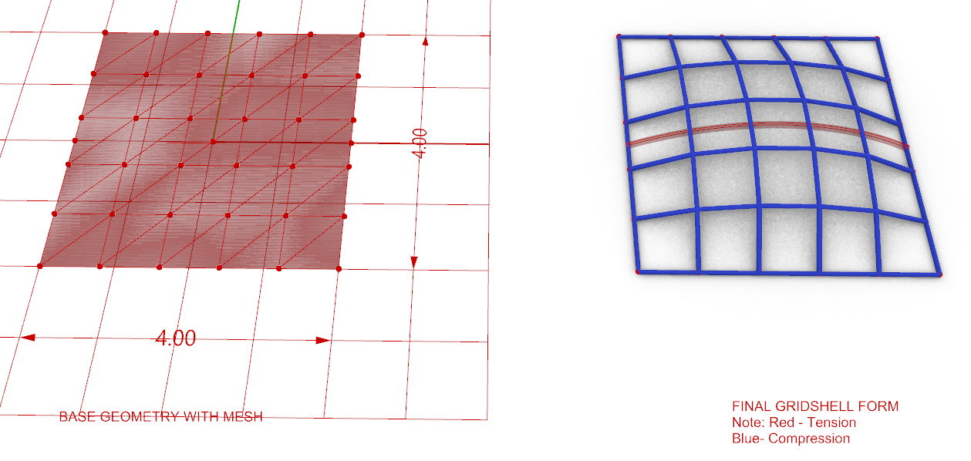
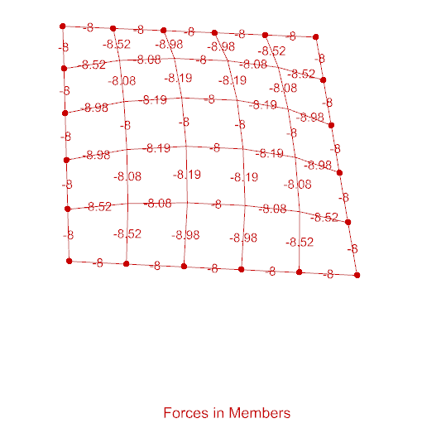
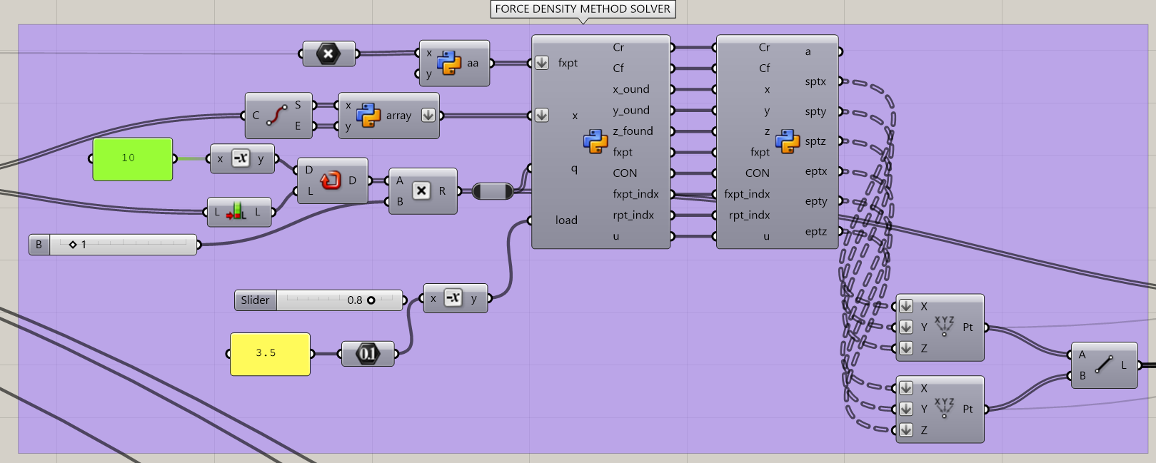
VALIDATION OF FDM Formulation
FDM of Analysis
FDM Analysis
Uniformly Distributed Roof Load |  |  |  | Remarks
Dead Load |  | 4 | KN/m2
Live Load |  | 1.2 | KN/m2
Total Load |  | 5.2 | KN/m2
Factored Load |  | 7.8 | KN/m2 | 1.5( DL + LL)
Span along X direction |  | 4 | m
Span along Y direction |  | 4 | m
Area |  | 16 | m2
No. of Divisions along x |  | 5
No. of divisions along y |  | 5
Total Nodes |  | 36
Wt/node |  | 3.47 | KN | Gravity
Edge Length Assumed |  | 0.80 | m
Force Density Assumed | q | 10 | KN/m
Average Length | l | 0.8 | m
Force assumed in member |  | 8.00 | KN
Take Steel Strength |  | 250 | Mpa
Take allowable stress |  | 217.5 |  | 0.87 * Strength

Slide 22
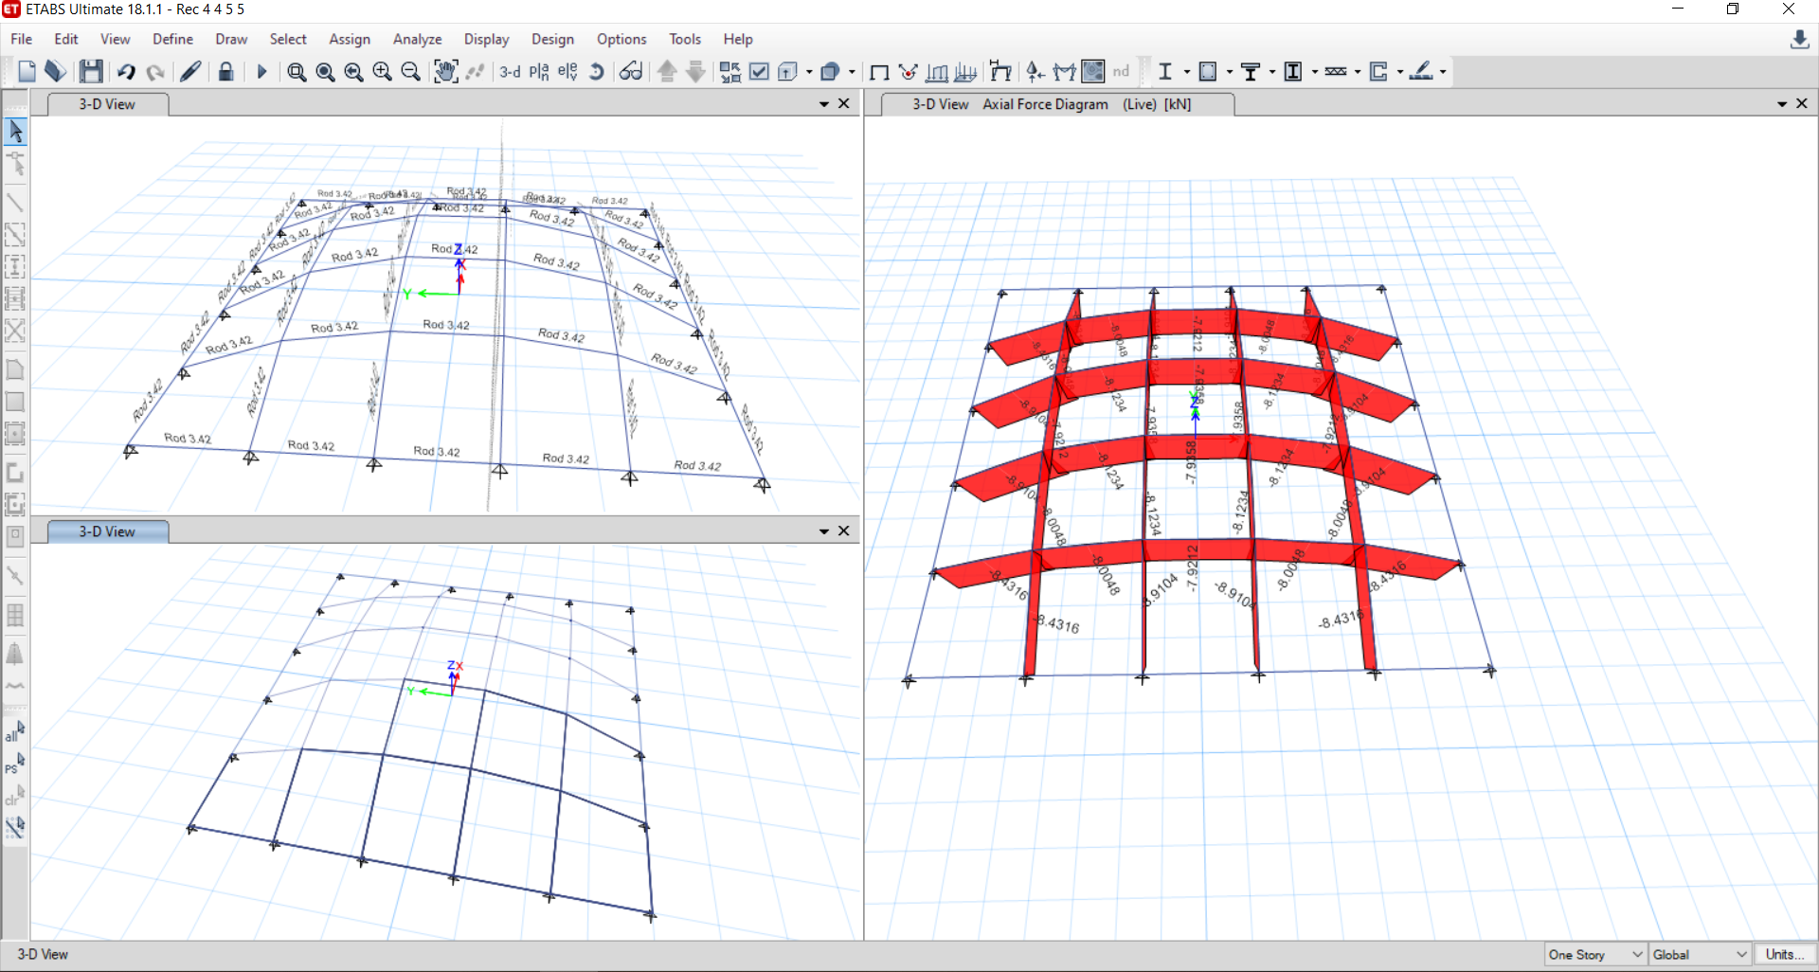
VALIDATION OF FDM Formulation
FEM Modelling
Software | ETABS v.18
Material property | 250 | Mpa | Fe250
Loading per nodes | 3.47 | KN | Gravity
Member end connection | Fixed
Support connection | Pinned

Slide 23
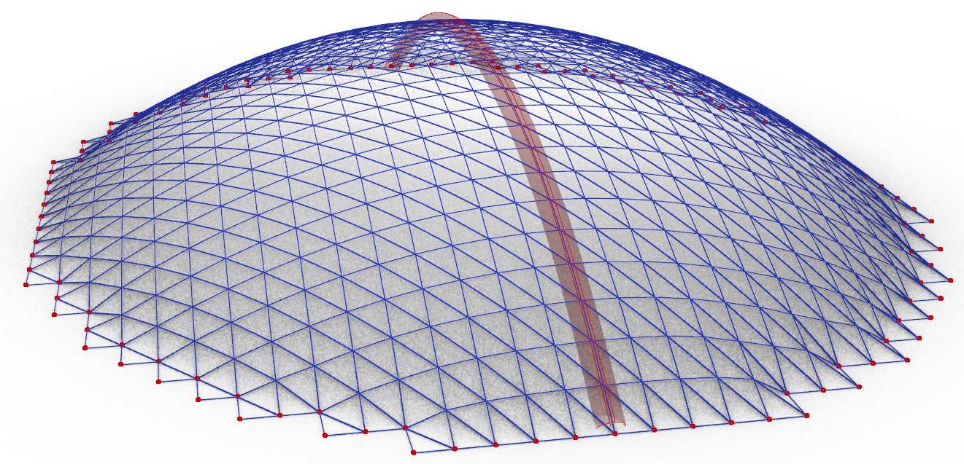
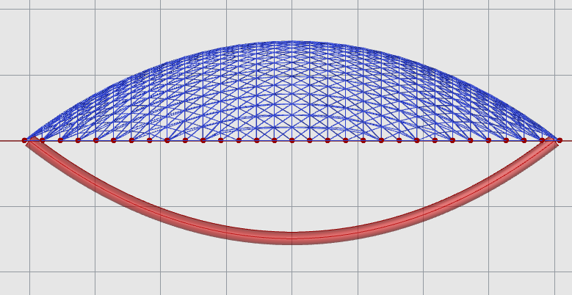
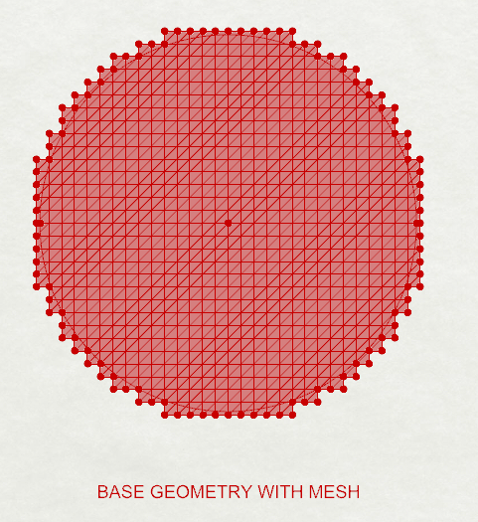
Force Density Method
Funicular Circular Shell Corresponding to Catenary ( reversed)
The 17th-century scientist Robert Hooke wrote: "Ut pendet continuum flexile, sic stabit contiguum rigidum inversum", or, "As hangs a flexible cable so, inverted, stand the touching pieces of an arch."

Slide 24
RESULTS
Form Finding Shells with Irregular Boundary Shapes
Study of Variation of weight, height and deflection of 12m*12m grid-shell and determination of optimum configuration for minimum weight within given height limitation.
Design of Self-supporting Grid-shells using Airy Stress Function

Slide 25
RESULTS
Form Finding Shells with Irregular Boundary Shapes

Slide 26
RESULTS
2. Study of Variation of weight, height and deflection of 12m*12m grid-shell and determination of optimum configuration for minimum weight within given height limitation.
Topology – quadrilateral grids (quadrangular and diamond shaped) and triangular grid of 3 types as shown in Figure
Grid density or number of subdivisions of span ranging from (6 to 24)
Force density ranging from (20 KNm−1 to 60 KNm−1)

Slide 27
RESULTS
2.1 Effect of variation of topology in shell height, weight and deflection for 8 subdivisions and 25 KNm⁻¹ force density .
Grid Type | Load path (KNm) | Normalized Load path | Shell height (m) | Normalized shell height | Deflection (mm) | Normalized shell deflection
Diamond | 8617.82 | 0.61 | 3.31 | 1.00 | 2.686 | 0.63
Triangular 1 | 13962.97 | 1.00 | 1.54 | 0.46 | 2.815 | 0.66
Triangular 2 | 13706.90 | 0.98 | 1.53 | 0.46 | 4.282 | 1.00
Triangular 3 | 14017.73 | 1.00 | 1.24 | 0.37 | 2.497 | 0.58
Quadrilateral | 7984.91 | 0.57 | 3.26 | 0.98 | 1.142 | 0.27

Slide 28
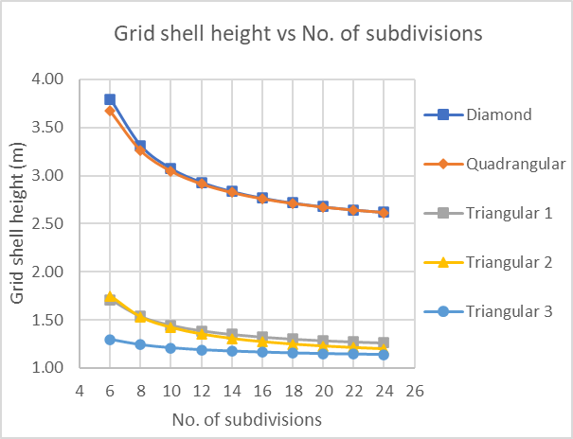
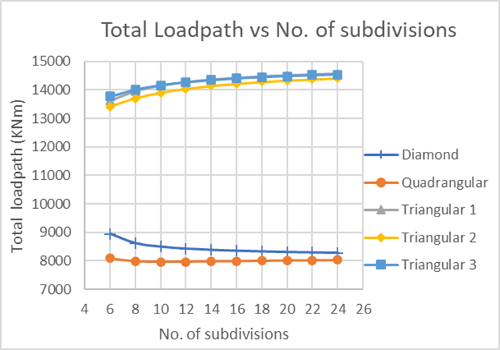
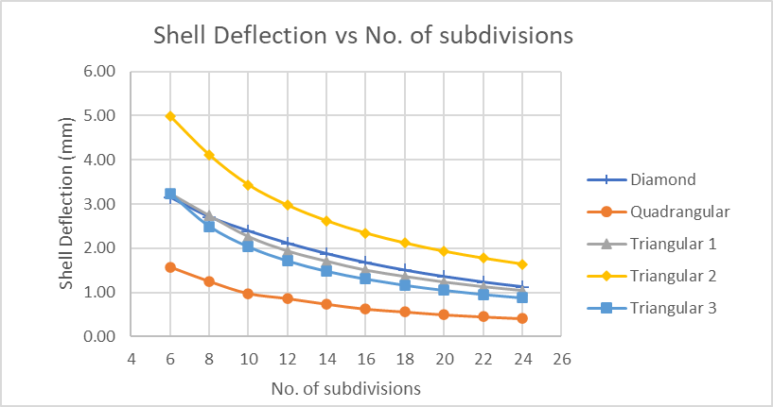
RESULTS
2.2 Variation of height, weight and deflection with subdivisions for constant force density = 25KNm⁻¹.

Slide 29
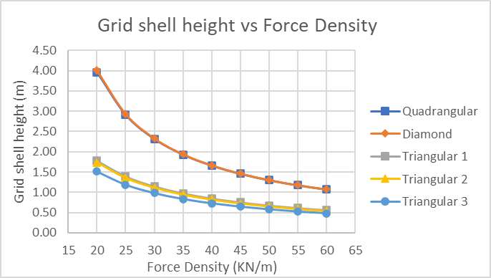
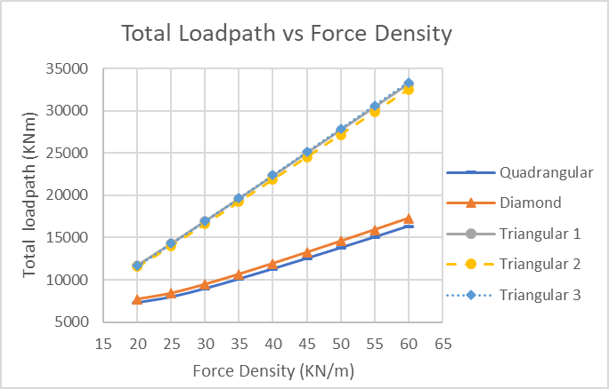
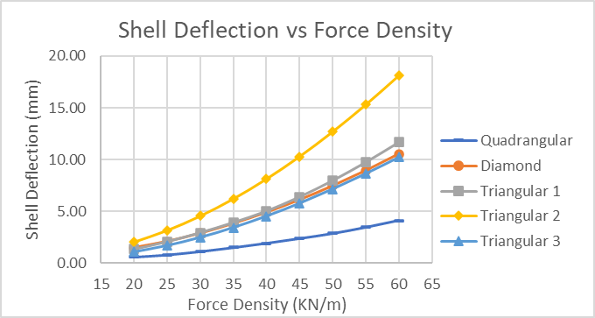
RESULTS
2.3 Variation of height, weight and deflection with force density for 12 subdivisions.

Slide 30
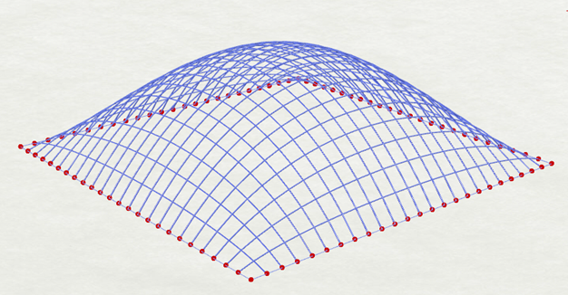
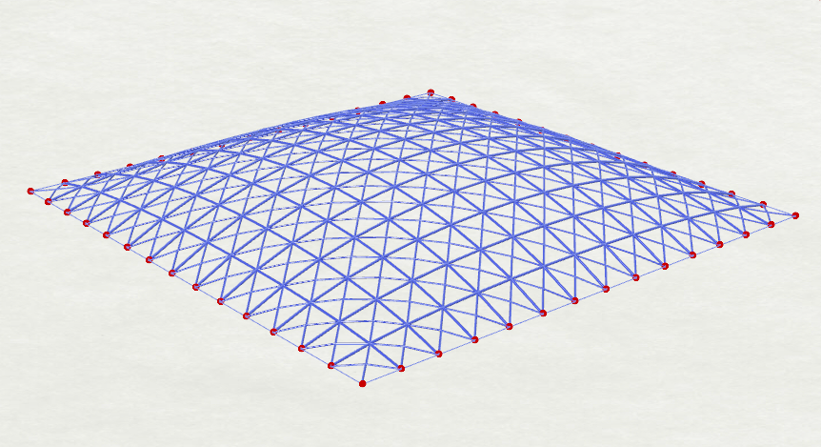
RESULTS
3. Optimization results for structural weight and height.
S.no. | Cases | Grid type | No. of subdivisions | Total loadpath (KNm) | Structural height (m) | Force density (KNm⁻¹)
1 | Minimize Structural weight | Quadrangular | 24 | 7136.3 | 3.51 | 20
2 | Height =1.5m | Triangular 3 | 14 | 11700.76 | 1.49 | 20

Slide 31
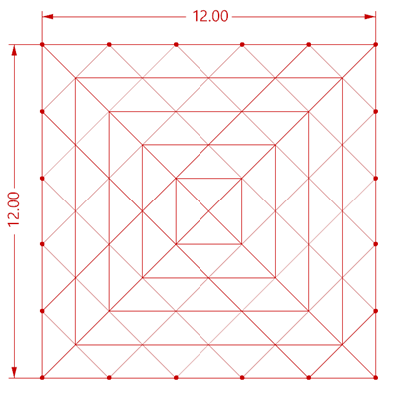
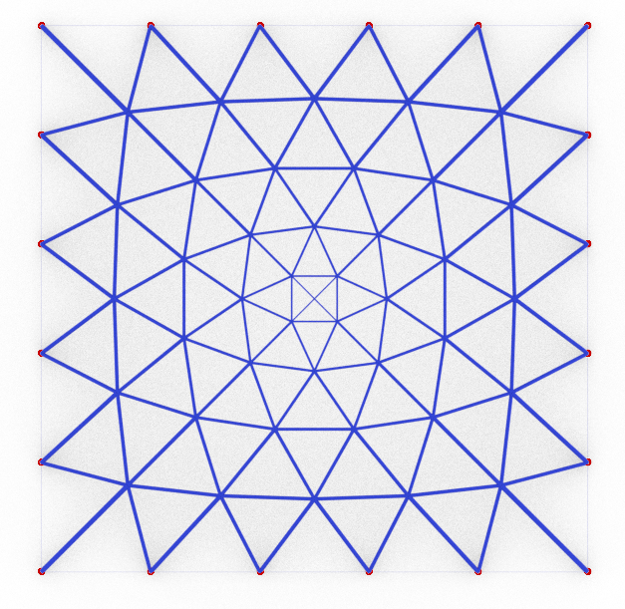
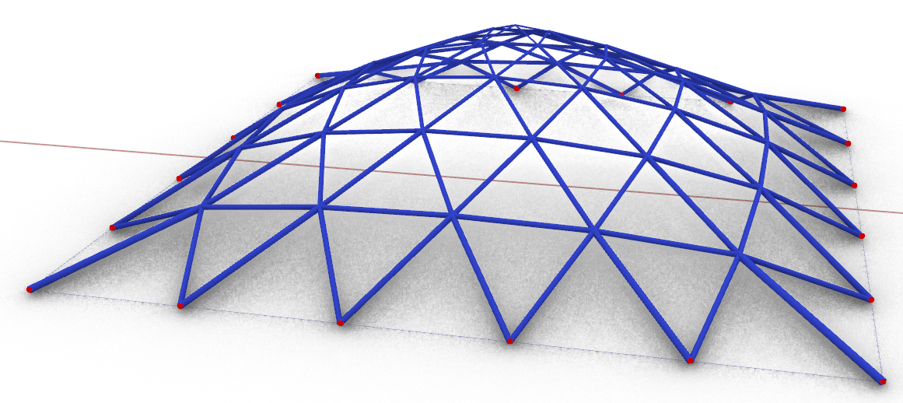
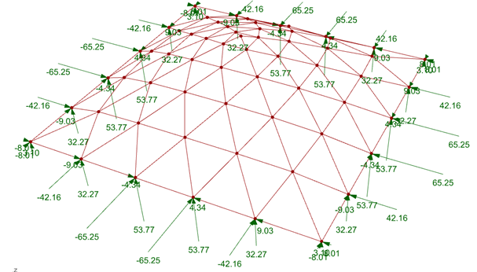
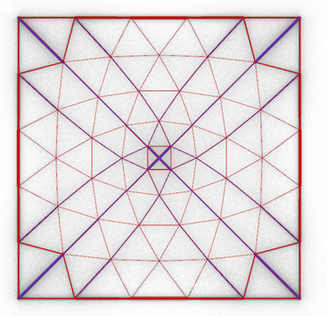
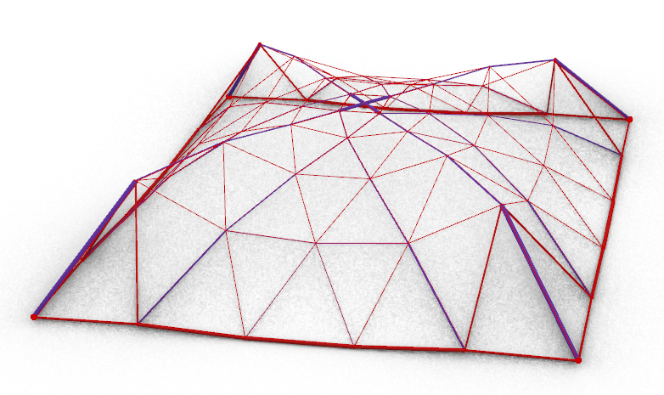
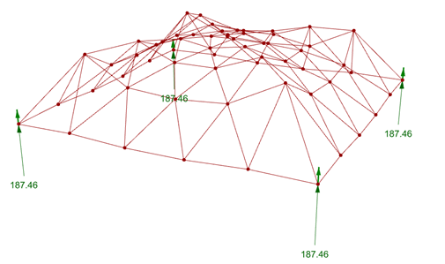
RESULTS
4.1. Rectangular Grid shell using Airy Stress Function.
Grid shell geometry obtained using uniform force density value
Grid shell geometry obtained using force density values from stress polyhedron taken grid shell above.

Slide 32
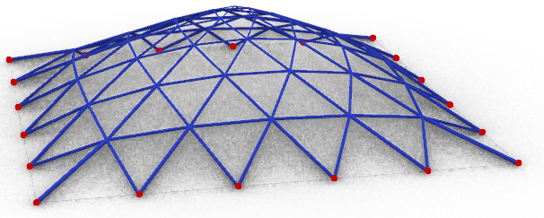
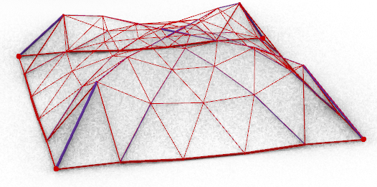
RESULTS
4.1 Comparison of basic parameters of shells using FDM and FDM + Stress Function
Parameter |  | Case I - FDM | Case II - FDM + AIRY
Structural weight | Kg | 1149.25 | 1852.6
Shell height | M | 2.89 | 2.85
Vertical deflection | mm | 5 | 98
Fundamental time-period | S | 0.042 | 0.27
Force Type |  | Compression only | Both Compression and Tension
Minimum force in member | KN | 9.86 | -9.83 (Compression)
Maximum force in member | KN | 44.1 | -261.53 (Compression)
Members used |  | ISNB40M, ISNB50M | ISNB40M, ISNB50M, ISNB80M, ISNB110M
Reaction Type |  | Reaction along all three axes at each support. | Reaction only along z axis at all support.

Slide 33
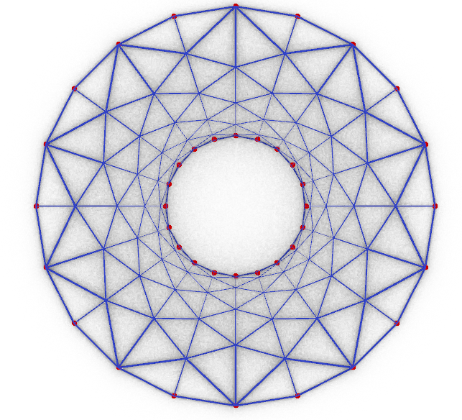
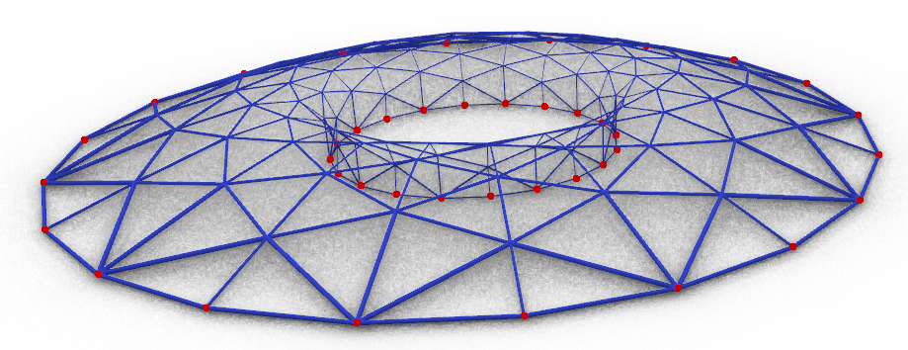
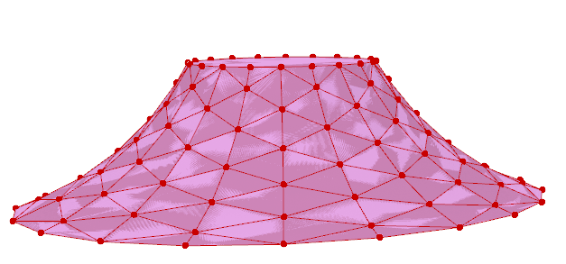
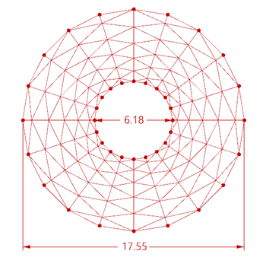


RESULTS
4.1 Comparison of basic parameters of shells using FDM and FDM + Stress Function for circular type grid shell
Stress Polyhedron taken for comparison
Grid shell geometry obtained by uniform force density.
Projection of Stress polyhedron
Grid shell geometry obtained by force density values from stress polyhedron.

Slide 34
RESULTS
4.2 Comparison of basic parameters of shells using FDM and FDM + Stress Function for circular type grid shell.
Parameter |  | CASE I (FDM) | CASE II (FDM + AIRY)
Structural weight | Kg | 2102 | 2120
Shell height | M | 1.39 | 1.37
Vertical deflection | mm | 16 | 38
Fundamental time period | S | 0.053 | 0.047
Force Type |  | Compression only | Both Compression and Tension
Maximum Compressive force in member | KN | 46.7 | 168.69
Maximum Tensile force in member | KN | - | 38.12
Members used |  | ISNB40M, ISNB50M | ISNB40M, ISNB65M
Reaction Type |  | Reaction along all three axes at each support. | Reaction only along z axis at all support.

Slide 35






RESULTS
4.3 Structures obtained by varying supports in
stress polyhedron projection.
Member network in 2D as projection of plane faced polyhedron. Support is shown as dot.
Compression -Tension Pin joined structure obtained with given airy stress function and support condition.

Slide 36
CONCLUSIONS
Design tool has been developed that can be used for form finding and optimization of grid-shells at early design phase.
Effect of variation of shell topology, subdivisions and force density values in shell height, weight and deflection has been studied.
Airy Stress Function can be utilized to generate self –supporting ( lateral direction) grid shells of similar weight to funicular shells.

Slide 37
ANNEX - I
Lateral Loading in various shell geometries.
Wind load intensity taken = 2 KNm-2
Gravity loading = 5 KNm-2
Grid shell Plan Dimensions = 12 m * 12m with 20 subdivisions in each side.
Grid shell Height taken = 3.5m
Grid shell type | Max deflection (mm) |  |  | Mass (kg)
 | x | y | Z
Spherical | 2 | 0.4 | 1.5 | 1720.87
Pyramid | 74 | 11.7 | 11.4 | 2608.08
Form found using FDM | 1 | 0.4 | 0.8 | 1565.6

Slide 38
THANK YOU.

